Slide 1

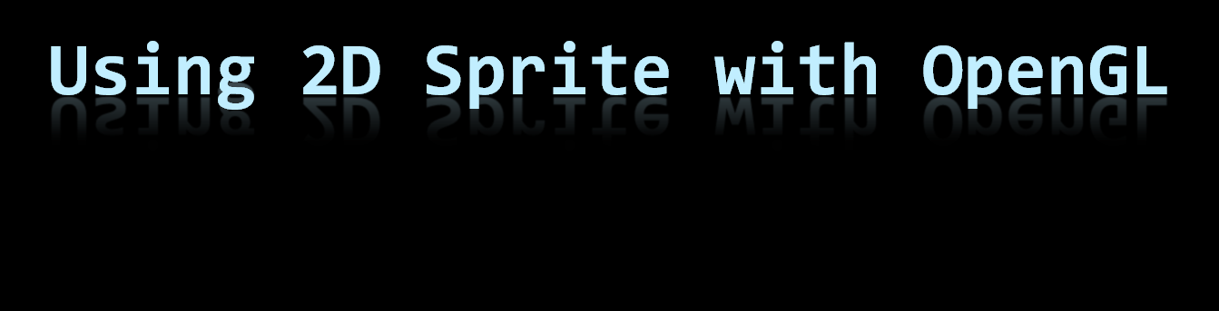
2010.4.8

Slide 2
Overview
Basic requirements of implementation
Image resource
Texture mapping
Advanced requirements of implementation
KGL sprite class & example
Demo

Slide 3
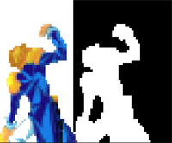
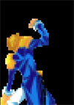

Basic requirements of implementation ( 1/2 )
Load image files that you need , transform their data into OpenGL and bind them in a proper way
Image color keying for background removal
background
to remove
zoom in
color keying
original image
character
to draw
background removal

Slide 4

Basic requirements of implementation ( 2/2 )
Hold the position and size of the sprite , and so we can move it or span it freely
By controlling the texture coordinates , we can play a sequence of animation frames in a same image
Time t0
Time t0+1

Slide 5
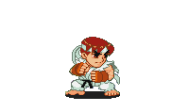
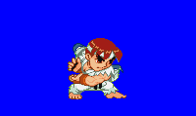

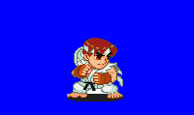
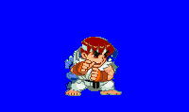
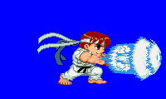
Image resource
Multiple images or Texture Atlas
Four Image with difference Texture ID
Swap Texture coord. in timer
Swap Texture ID in timer
Packing all texture in one atlas

Slide 6
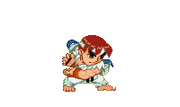

Image resource
Multiple images or Texture Atlas
Four Image with difference Texture ID
Swap Texture coord. in timer
Swap Texture ID in timer
Packing all texture in one atlas

Slide 7

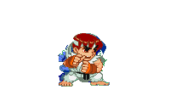
Image resource
Multiple images or Texture Atlas
Four Image with difference Texture ID
Swap Texture coord. in timer
Swap Texture ID in timer
Packing all texture in one atlas

Slide 8

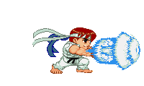
Image resource
Multiple images or Texture Atlas
Four Image with difference Texture ID
Swap Texture coord. in timer
Swap Texture ID in timer
Packing all texture in one atlas

Slide 9
Texture mapping
(0, 1)
texture
(1, 1)
The coordinate of a texture is normalized into an 2d unit square
(0, 0.45)
(0.36, 0.45)
(0, 0)
(0.36, 0)
(1, 0)

Slide 10
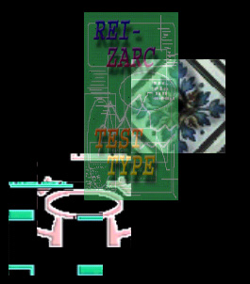
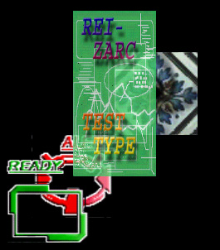
Advanced requirements of implementation ( 1/2 )
( In this section , we take more from OpenGL )
Taking advantage of alpha buffer and depth buffer , we can happily create the effect of transparency with little effort
This effect alpha blending is a standard function in OpenGL
To use it , it is necessary to set
frame color buffer as RGBA
The value of alpha to form different level of transparency
can be set both in image data and in color4 value

Slide 11
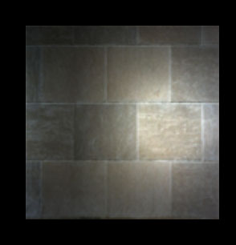
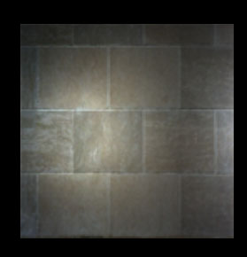
Another things…
Again , we control the texture coordinates to add the function of scrolling the image
It is convenient and useful to perform some small sprite automatic action if we add a frame ( or time ) counter into it
In this example , a sprite of
spotlight is drawn over a sprite
of wall texture , and the spot
light is controlled to scroll
again and again

Slide 12
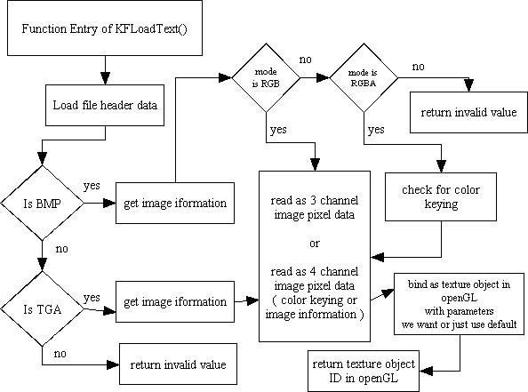
KGL sprite class

Slide 13
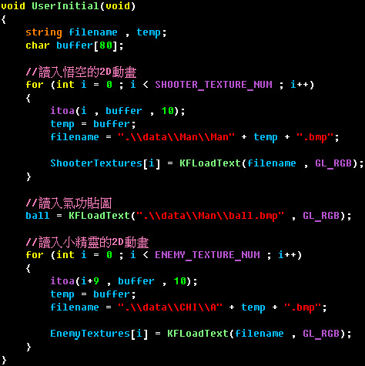
KGL sprite example(1/2)
KFLoadText()
will return the index of the texture we load

Slide 14
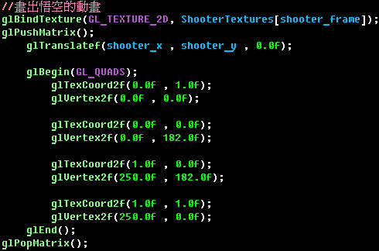
KGL sprite example(2/2)
mapping the texture onto a quad

Slide 15
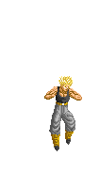
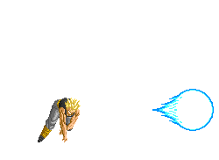
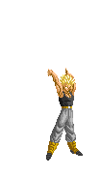
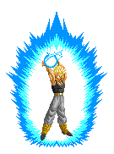

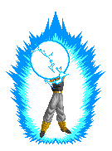
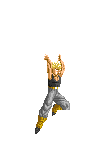
Demo
Sequentially load the textures below,
then it will become an animation

